Slide 1
Crafting & Compelling Website Analysis
Name: Maria Salma Burke
Batch Code: MB28
Mail ID: mariaburke2k@gmail.com

Slide 2
Project overview Consider that you are working at reputed company in the role of a digital marketing analyst or SEO analyst. In this project, you will delve into the fundamentals of digital marketing, focusing on website and landing page design. The tasks include understanding how to design and build a compelling web presence by grasping the inner workings of websites, key ingredients, and essential design principles. Through hands-on activities and real-time exercises, you will create landing pages from scratch, applying digital marketing strategies and best practices in website design.

Slide 3
Company Selection
I selected the company “HCLTECH” for this web presence project.
HCL Technologies Limited is an Indian multinational information technology consulting company headquartered in Noida. HCL was established in 1976 as one of India's original IT start-ups.
The company offers a diverse range of solutions in IT infrastructure management services, digital process operations, industry software services, and engineering and R&D services. HCL offers its services to financial services, manufacturing, telecom, retail and consumer packaged goods services, media and entertainment, life sciences, insurance services, capital markets services, banking services, mining, and natural resources. It also serves the oil and gas, aerospace and defense, automotive, chemical and process industries, hi-tech, industrial manufacturing, energy and utility, healthcare, travel, transport, hospitality, and logistics sectors.

Slide 4
Product and Service Descriptions
Automotive: At HCLTech, we combine advanced technologies with strong strategies to help automotive companies thrive. We guide you into the future by offering practical solutions, connecting you with our wide range of partners, turning your resources into valuable platforms, improving your infrastructure, and using efficient engineering methods.
Manufacturing:
With over 40 years of experience, HCLTech has helped manufacturing companies change their old ways of working into modern operations that use data to improve profits and prepare for future growth.
Financial Services:
HCLTech brings together advanced technologies like cloud, digital tools, and AI with solid strategies to create powerful solutions that help businesses move forward into the future.

Slide 5
Website Platform Identification
The HCLTECH website uses a variety of technologies, which we found using a tool called Wappalyzer. Knowing what these technologies are is important because it helps us understand how to connect with them, how well they work, and how secure they are for our projects.
Category | Technology
CMC | Drupal
Webmail | Microsoft 365
Programming language | PHP
Video Players | Youtube & Vimeo
UI Frameworks | Bootstrap
Font scripts | Font Awesome
Cookie compliance | Onetrust
Advertising | Twitter Ads & Goodle Ads
Caching | Varnish
Tag managers | Google Tag Manager
A/B Testing | VWO
Analytics | Facebook Pixel, VWO, Leadfeeder, LinkedIn Tag, etc
Development | Styled-components & Anima
Performance | Priority Hints
Marketing automation | PathFactory, Eloqua & 6sense
Email | Microsoft 365
Digital asset management | Imgix

Slide 6
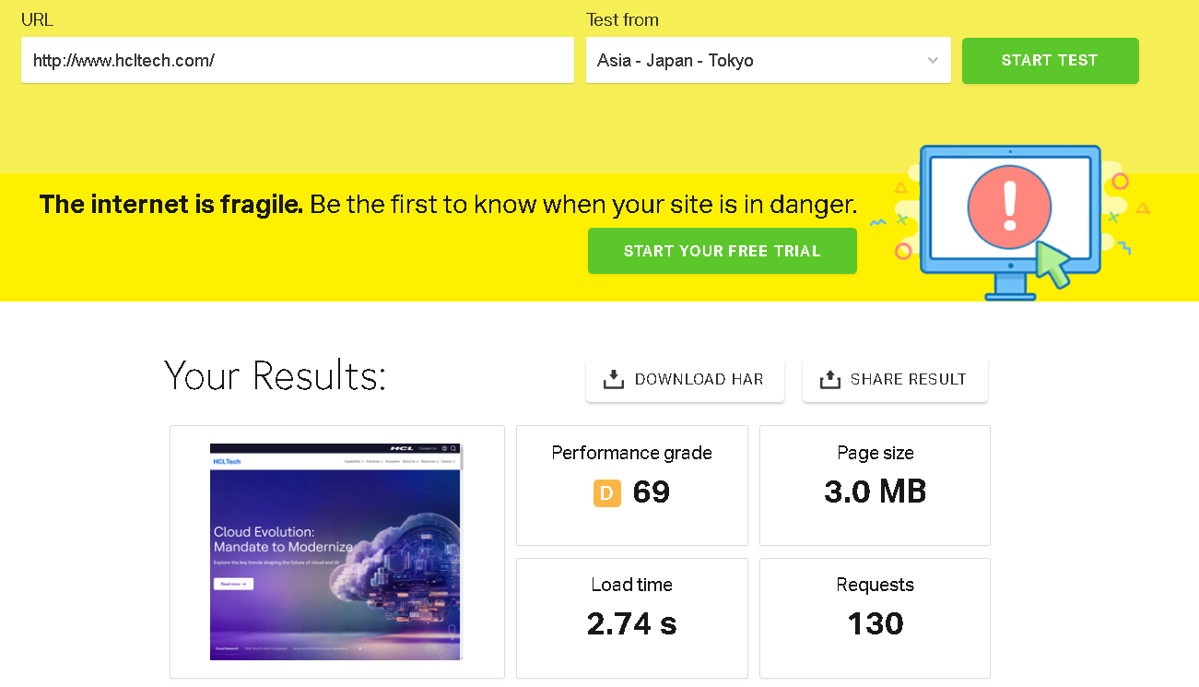
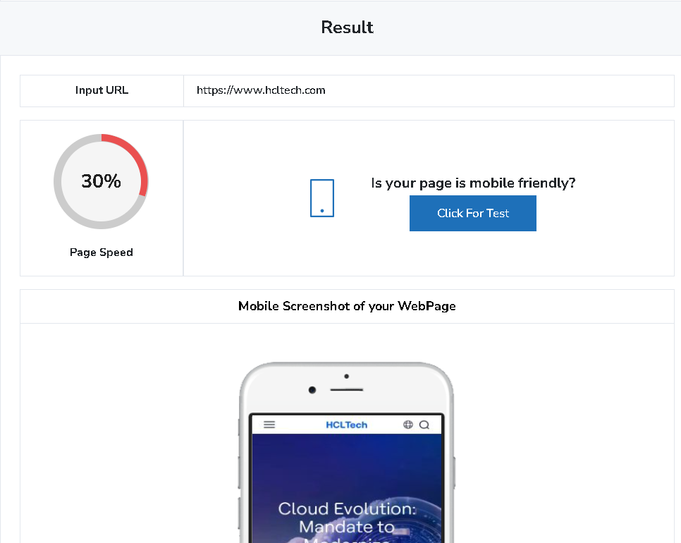
Responsive Design Testing
Tool: Pingdom & Google Mobile-Friendly Test
This website has a moderate performance grade of D (69) with page size of 3 MB.
Taking 2.74 seconds to load and making 130requests.
Page loading speed for mobile is 30%.

Slide 7
Website Mistakes Identification
Excessive Requests: 130 requests can overwhelm users and slow performance, suggesting excessive element loading
Cluttered Layout: If the design is cluttered, it can lead to confusion and difficulty in navigation
Lack of Optimization: Unoptimized images and media can slow load times and harm user experience
Page loading speed: Page loading percentage for mobile is only 30%

Slide 8
Improvement Recommendations
Performance Grade: C (75)
Minify CSS and JavaScript: Reduce file sizes by removing unnecessary characters, comments, and whitespace.
Leverage Browser Caching: Set appropriate cache headers to reduce load times for returning visitors Optimize Images: Use appropriate formats (e.g., WebP) and compress images without losing quality
Requests: 130
Combine Files: Merge CSS and JS files where possible to reduce the number of HTTP requests.
Use Sprites for Icons: Combine multiple images into a single sprite sheet to minimize requests for icon images.
Audit Third-Party Scripts: Review and eliminate unnecessary third-party scripts/services that contribute to high requests
Improving Mobile Loading Speed
The current mobile loading speed is at only 30%, it is crucial to implement targeted strategies to enhance performance. Slow loading times can significantly impact user experience, engagement, and conversion rates.

Slide 9
Website Best Practices
Responsive Design:
Design your website to be mobile-friendly and responsive for optimal user experience across all devices.
Clear Navigation:
Create intuitive navigation with clear labels and a logical hierarchy for easy information access.
Consistent Branding:
Use a consistent colour palette, typography, and imagery to reinforce your brand identity and build trust.
Effective Use of Whitespace: Utilize ample whitespace to create a clean layout that enhances readability and highlights key content.
Strong Call-to-Actions (CTAs): Create clear, visually distinct CTAs that guide users toward actions like signing up or making a purchase

Slide 10
Landing Page Design
Landing Page: https://app.site123.com/manager/wizard.php?wu=6709213ac5146-6709213ac5147-6709213ac5148&from=dash
Compelling Headline: Use a clear and attention-grabbing headline that immediately conveys the value proposition
Engaging Visuals: Incorporate high-quality images or videos that support the message and enhance user engagement Strong
Call-to-Action (CTA): Place a prominent, action-oriented CTA button that encourages users to take the desired action
Minimalist Layout: Use a clean, uncluttered design that highlights essential information and guides the user’s focus
Social Proof: Include testimonials, reviews, or trust badges to build credibility and reassure visitors about their decision

Slide 11
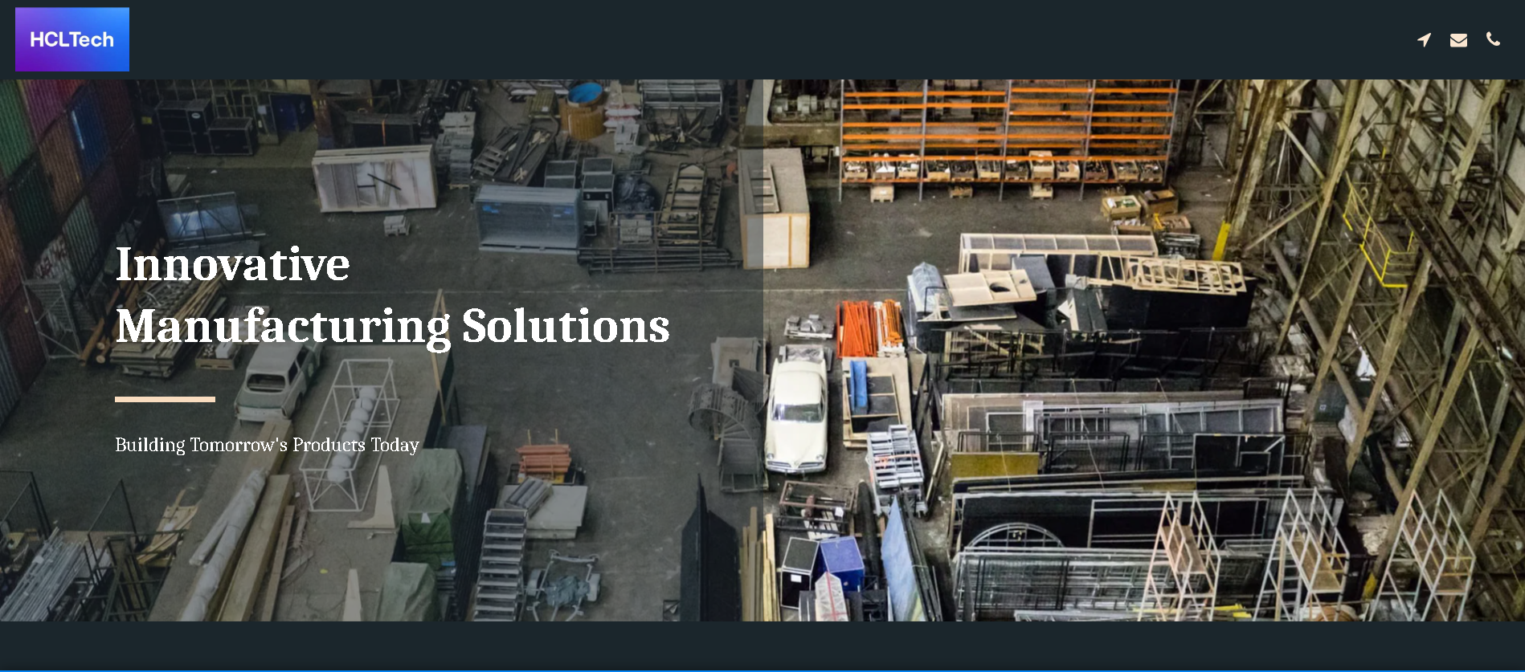

Slide 12
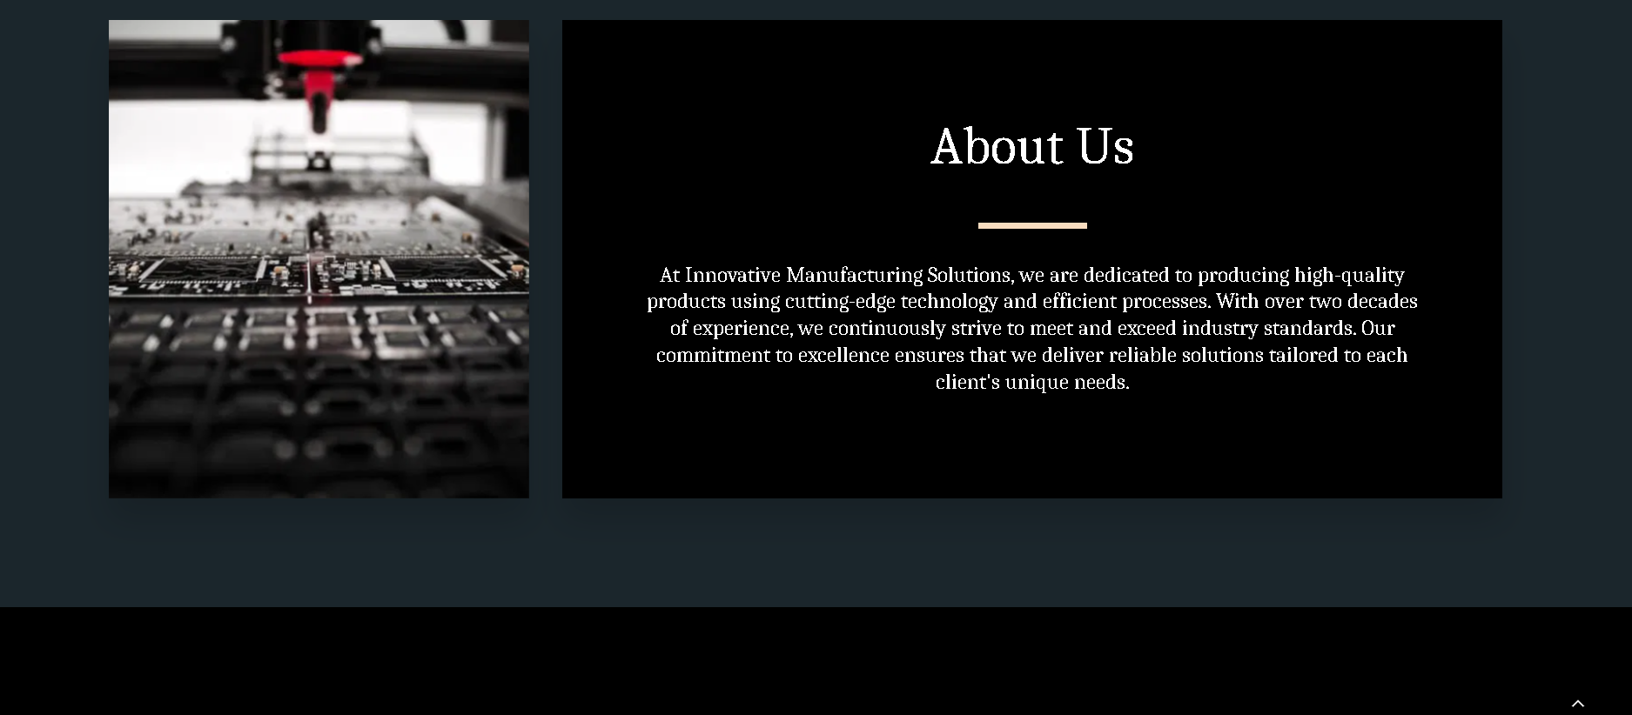

Slide 13
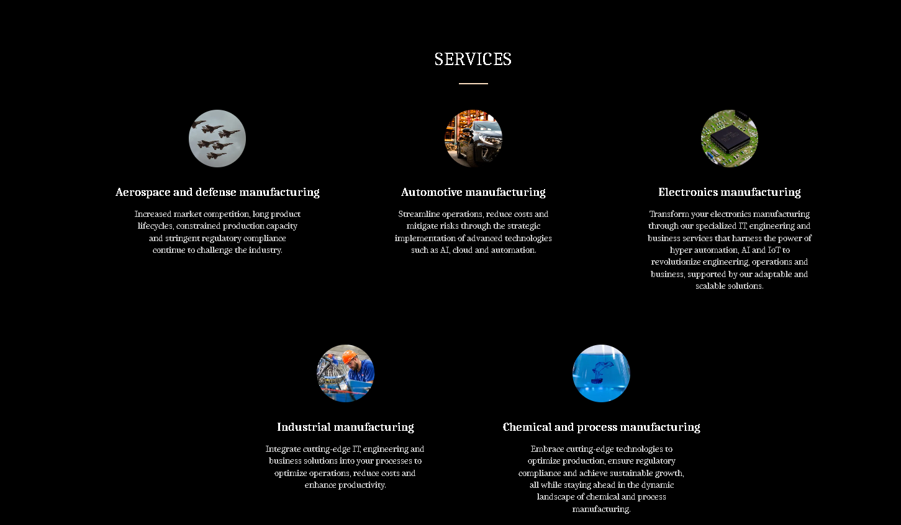

Slide 14
Thank You

